Slide 1

★ VOTE NOW ★
CLASS
ELECTIONS:
THE MOVIE
Eight friends. Four jobs. Zero qualifications.
A very serious look at democracy, AU01 to AU08.
● COMING TO A LECTURE HALL NEAR YOU ●
Notes:
Welcome to the campaign trail. Eight friends, four posts, absolutely zero credentials. Let's see what AU01 to AU08 are promising us.

Slide 2

AU01 TO AU08 ROSTER
MEET THE 8 BRAVE (OR BORED) SOULS
Toshima & Harshitha · Class Rep
Bridging student complaints and professor silence.
Adib & Hemanth · Sports Secretary
Grand tournaments, promised from the bench.
Samhitha & Darsh · Cultural Secretary
Snack supply lines versus mandatory auditorium dances.
Shafi & Sarang · Tech Secretary
One heroic router rebooter; one quiet legendary disappearance.
Notes:
Four key departments, eight nominees. Some want power, some want glory, and some just showed up because the nomination form was free.

Slide 3

CLASS REPRESENTATIVE
APPROVED
TOSHIMA: "I WILL IMPROVE COMMUNICATION"
1
The Grand Promise
Replies to urgent class group pings within 3 to 5 business semesters.
2
Secret Superpower
Says "noted" to everything, even 80-message faculty essay rants.
3
Official Slogan
Vote Toshima, she'll definitely read your message
Notes:
Toshima promises improved communication. In reality, she has 4,200 unread WhatsApp messages, but she will drop a thumbs-up emoji when you least expect it.

Slide 4

CLASS REPRESENTATIVE
APPROVED
HARSHITHA: THE COORDINATOR
1
Better Logistics
Better student coordination, starting with who brings the chalk.
2
The Intel Weapon
Maintains mental encyclopedia of everybody's fake attendance excuses.
3
Operational Hazard
Will call an emergency 45-minute meeting just to schedule future meetings.
Notes:
Harshitha runs class logistics like a military operation. If you skip class, she already knows your fake doctor's note was typed in Comic Sans.

Slide 5
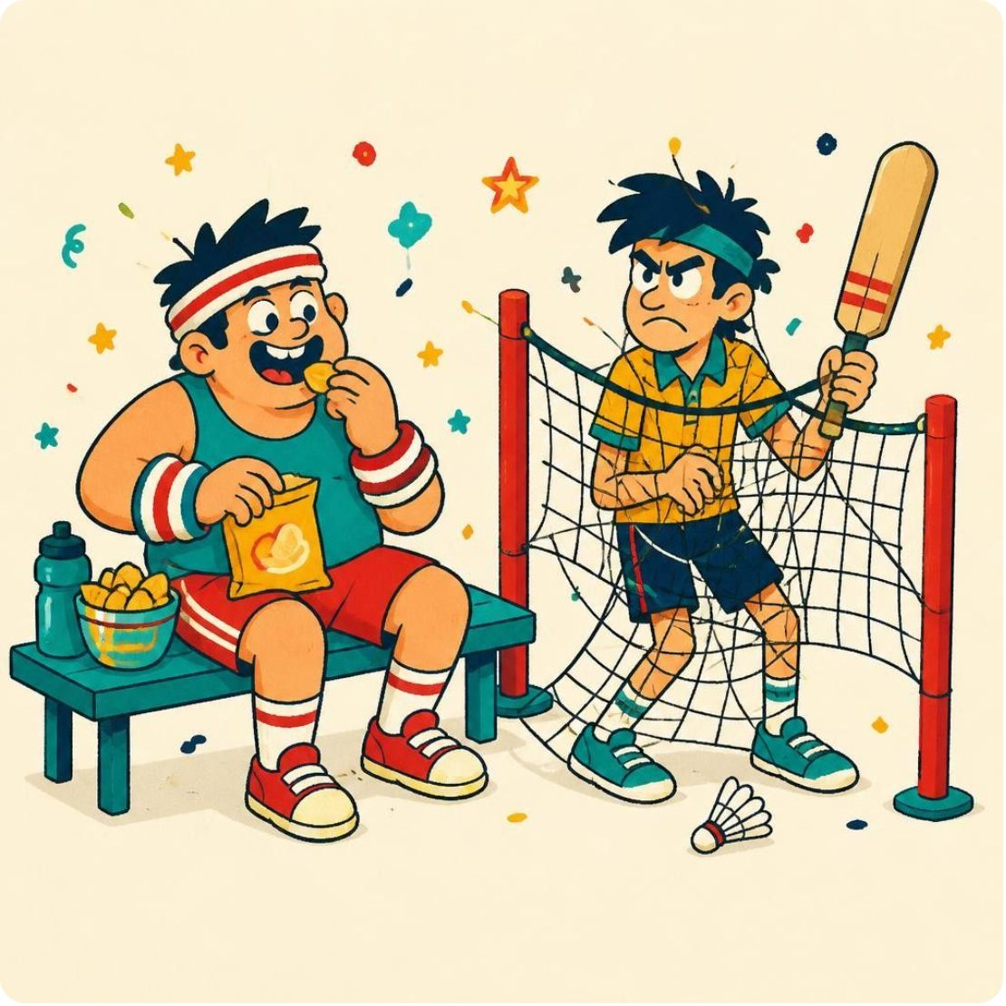
THE DERBY
ADIB VS HEMANTH: SPORTS SHOWDOWN
APPROVED
NOMINATED
Adib
Hemanth
THE TACTICIAN
THE OUTSIDER
Teamwork and sports activities, mostly from the bench.
Events for everyone, still waiting for his own vote.
STAKES: Winner picks who is captain of the cricket match nobody asked for.
Notes:
Adib is ready to cheer enthusiastically from the dugout, while Hemanth is still waiting for official election clearance. High-stakes athletics!

Slide 6

SAMHITHA VS DARSH: CULTURE CLASH
APPROVED
APPROVED
Samhitha
Darsh
SNACK DIPLOMACY
STAGE TYRANT
Manifesto: Creativity and participation. The hidden cost: Will physically drag shy back-benchers onstage for synchronized dance.
Manifesto: Cultural programs and celebrations. The actual guarantee: Premium samosas, chips, and juice boxes at every single gathering.
VERDICT: Both candidates approved. Nobody in the audience is safe.
Notes:
Vote Samhitha if you want free pastries. Vote Darsh if you want to be coerced into performing interpretive hip-hop in front of the dean.

Slide 7

TECH SECRETARY
APPROVED
SHAFI: TECH SECRETARY, WIFI HERO?
1
The Official Manifesto
Promote technology and technical events.
2
The True Metric
Fixing the projector in under 20 minutes.
3
Campus Folklore
Rumour: has turned it off and on again before.
Notes:
Forget AI and cloud computing. Shafi's entire election platform rests on whether he knows the campus Wi-Fi password that works in the cafeteria.

Slide 8
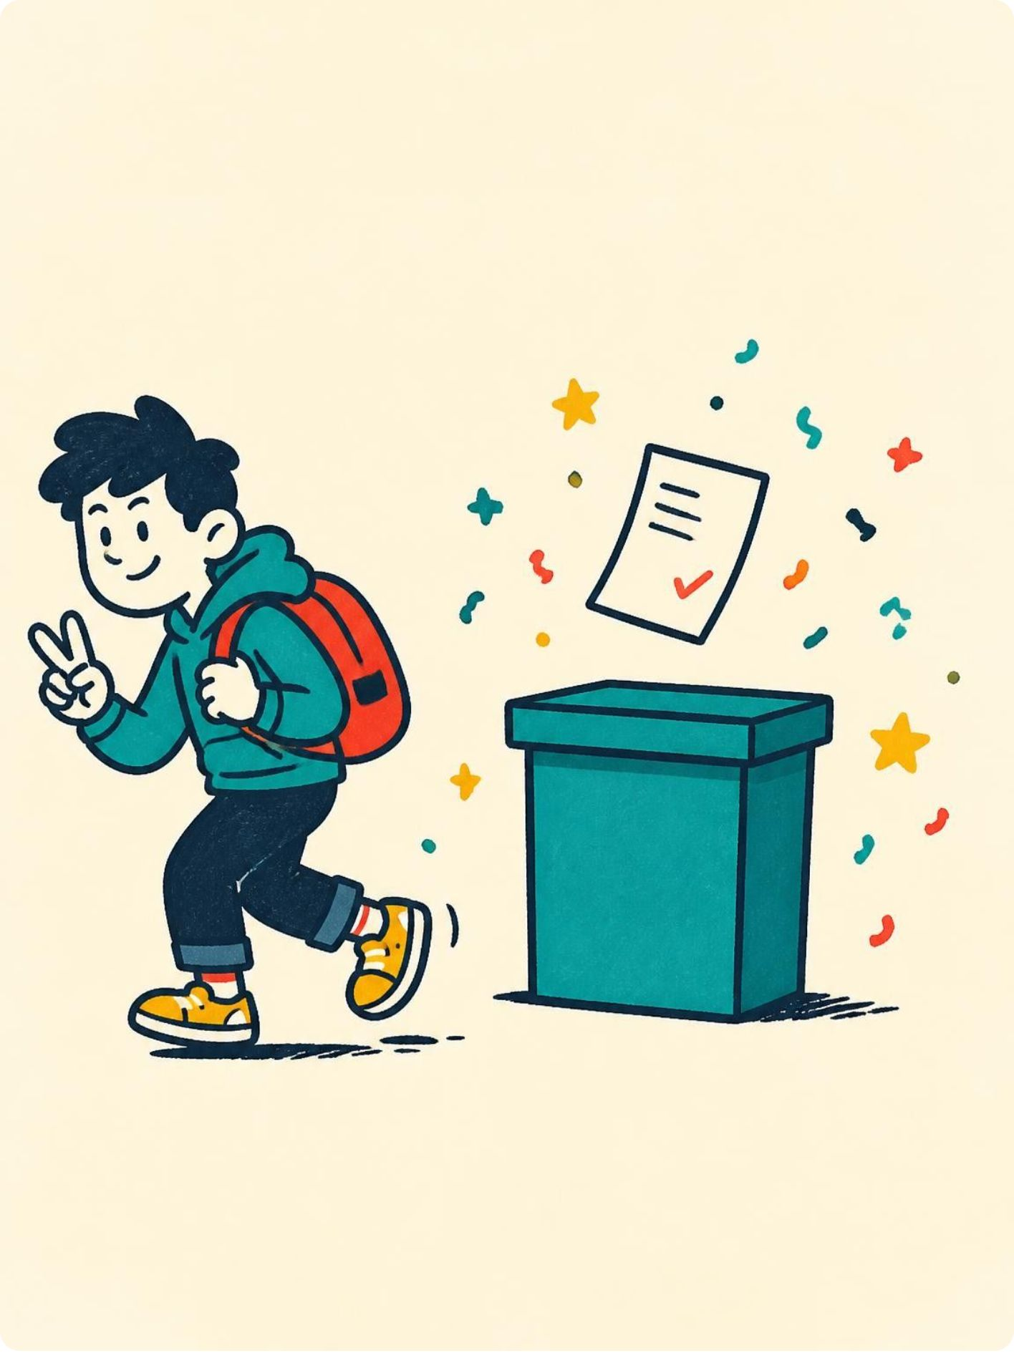
TECH SECRETARY
WITHDRAWN
SARANG: GONE BUT NEVER FORGOTTEN
1
The Vision That Was
Promised "innovative technical activities" before vanishing like a ghost.
2
Flawless Campaign Exit
Zero controversy, zero debates, 100% peaceful withdrawal approval.
3
The Suspected Trigger
Rumor has it he opened the campaign WhatsApp group once and immediately tapped out.
Notes:
Sarang had the smartest strategy in the entire election: he submitted the form, saw the chaos, and withdrew before anyone could ask him for a favor.

Slide 9

ELECTION COMMISSION
THE OFFICIAL STATUS REPORT
6
6 CANDIDATES · APPROVED
Fully cleared to make reckless campaign pledges.
1
HEMANTH · 1 NOMINATED
The world's longest-running pending clearance request.
1
SARANG · 1 WITHDRAWN
The only candidate who escaped with his dignity intact.
STAT: The 75% approval rate is statistically higher than our average mid-term marks.
Notes:
Six approved, one pending forever, and one who escaped. Democracy in its purest, most bureaucratic form.

Slide 10
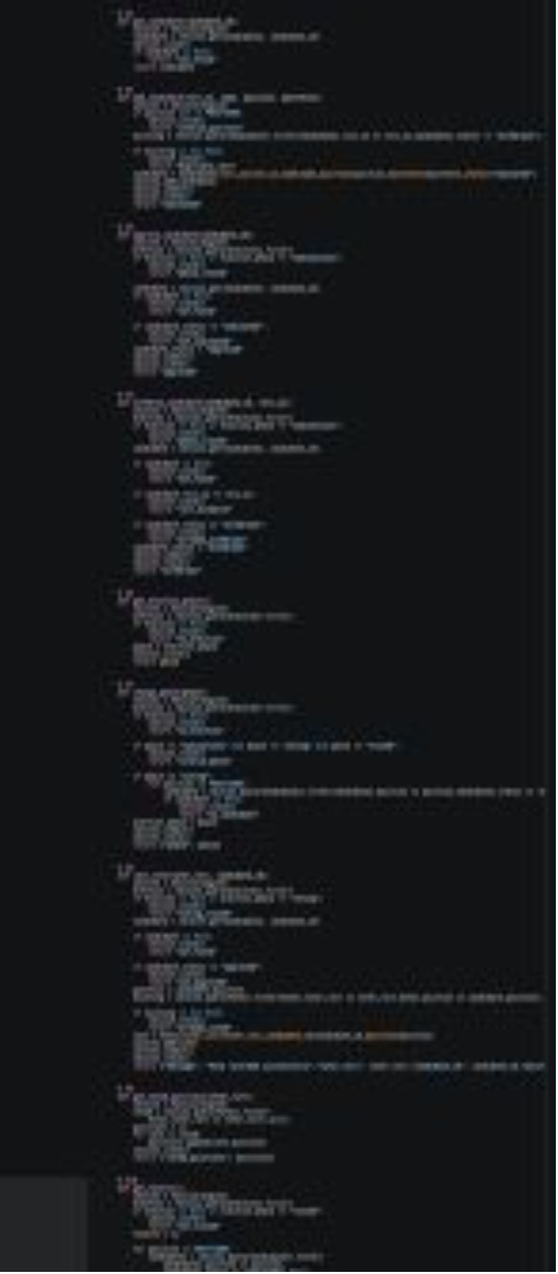
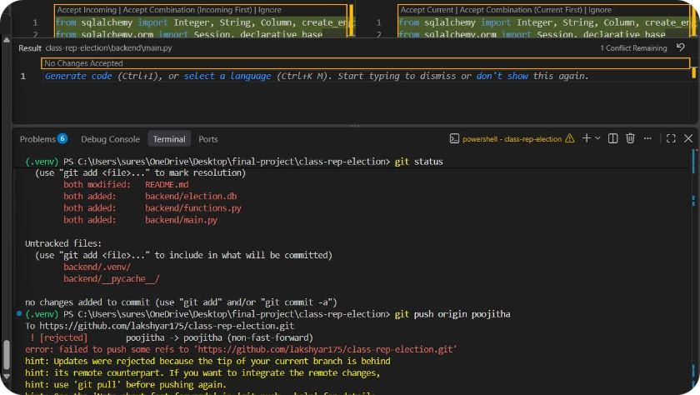
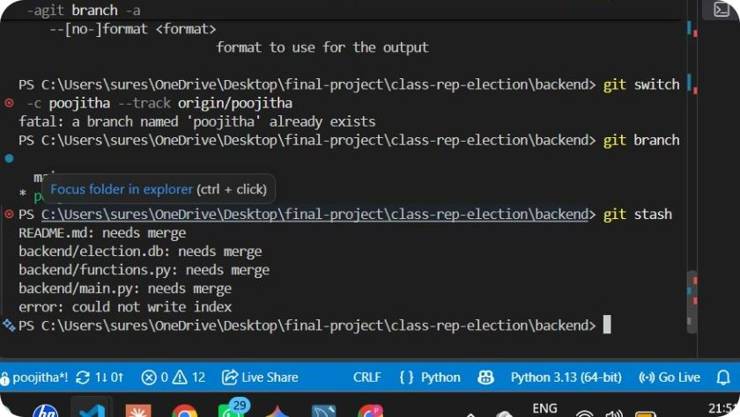
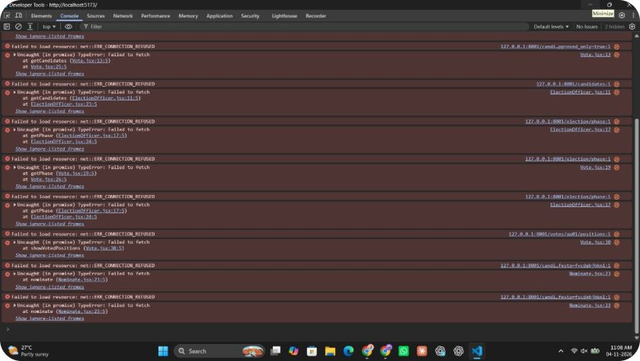
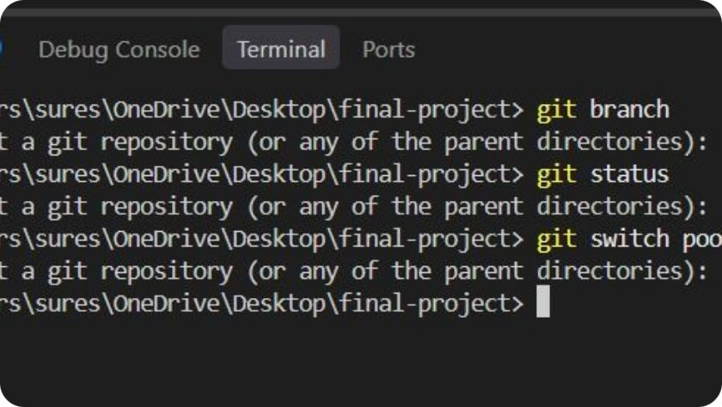
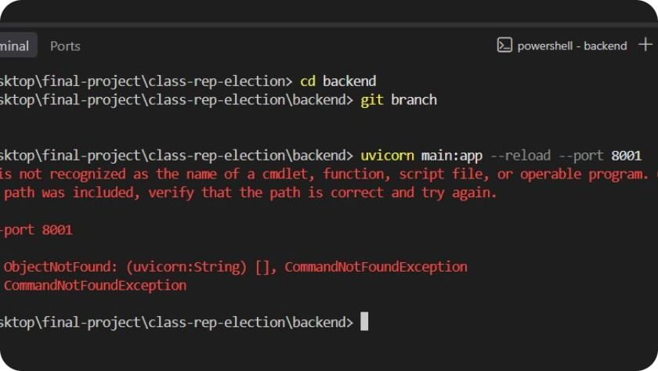
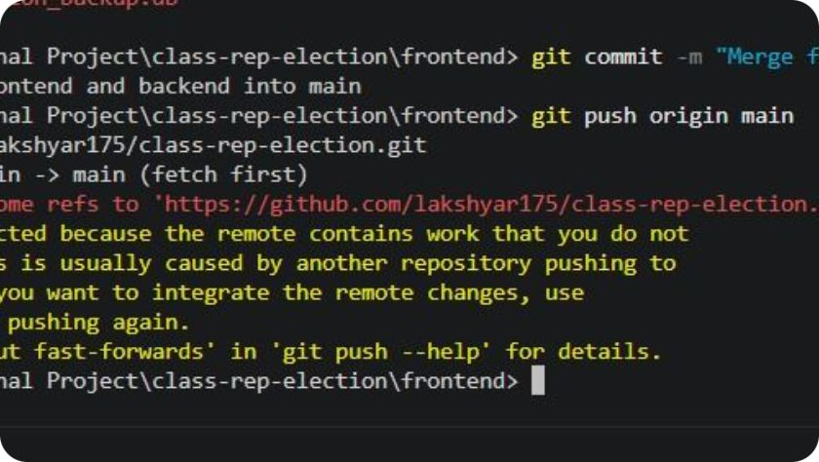
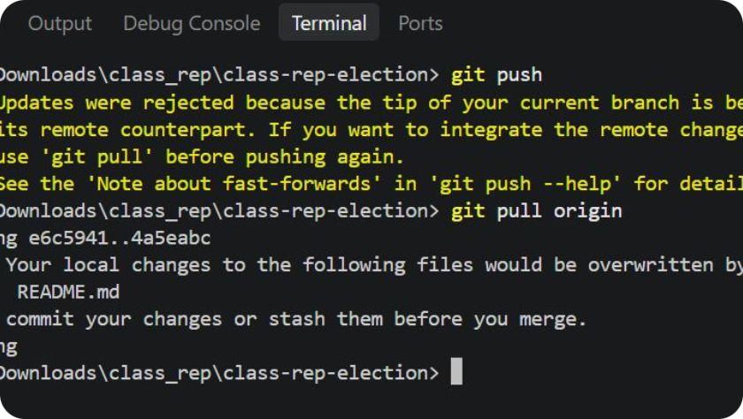
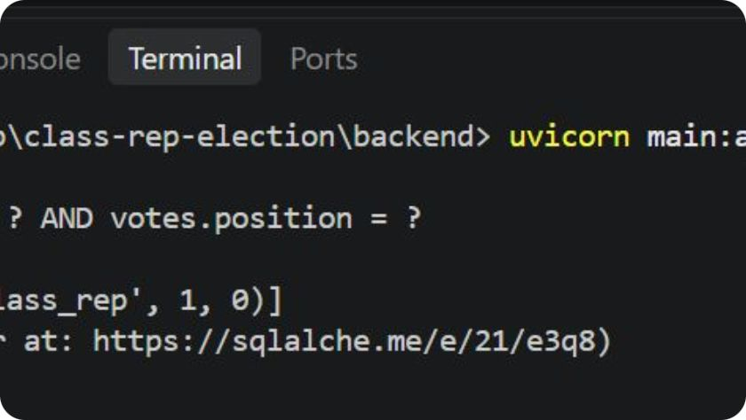
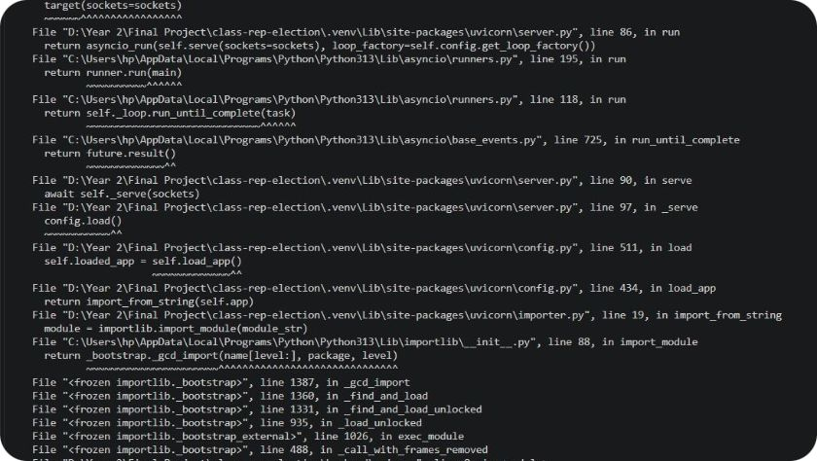
14
15
16
17
18
19
ERRORS
20
21
22

Slide 11
END
THE REAL WINNER OF EVERY ELECTION
“SAMOSAS!”
Notes:
And that is how democracy works. Vote wisely, don't expect free snacks, and remember to submit your assignments on time!

